Slide 1
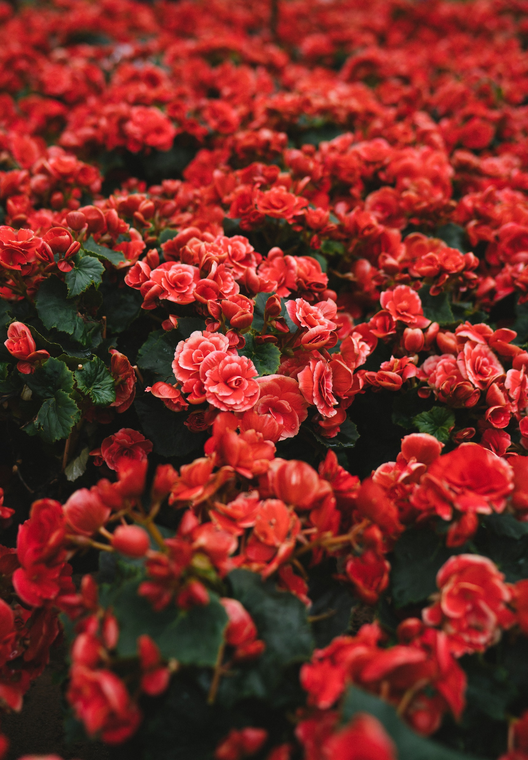



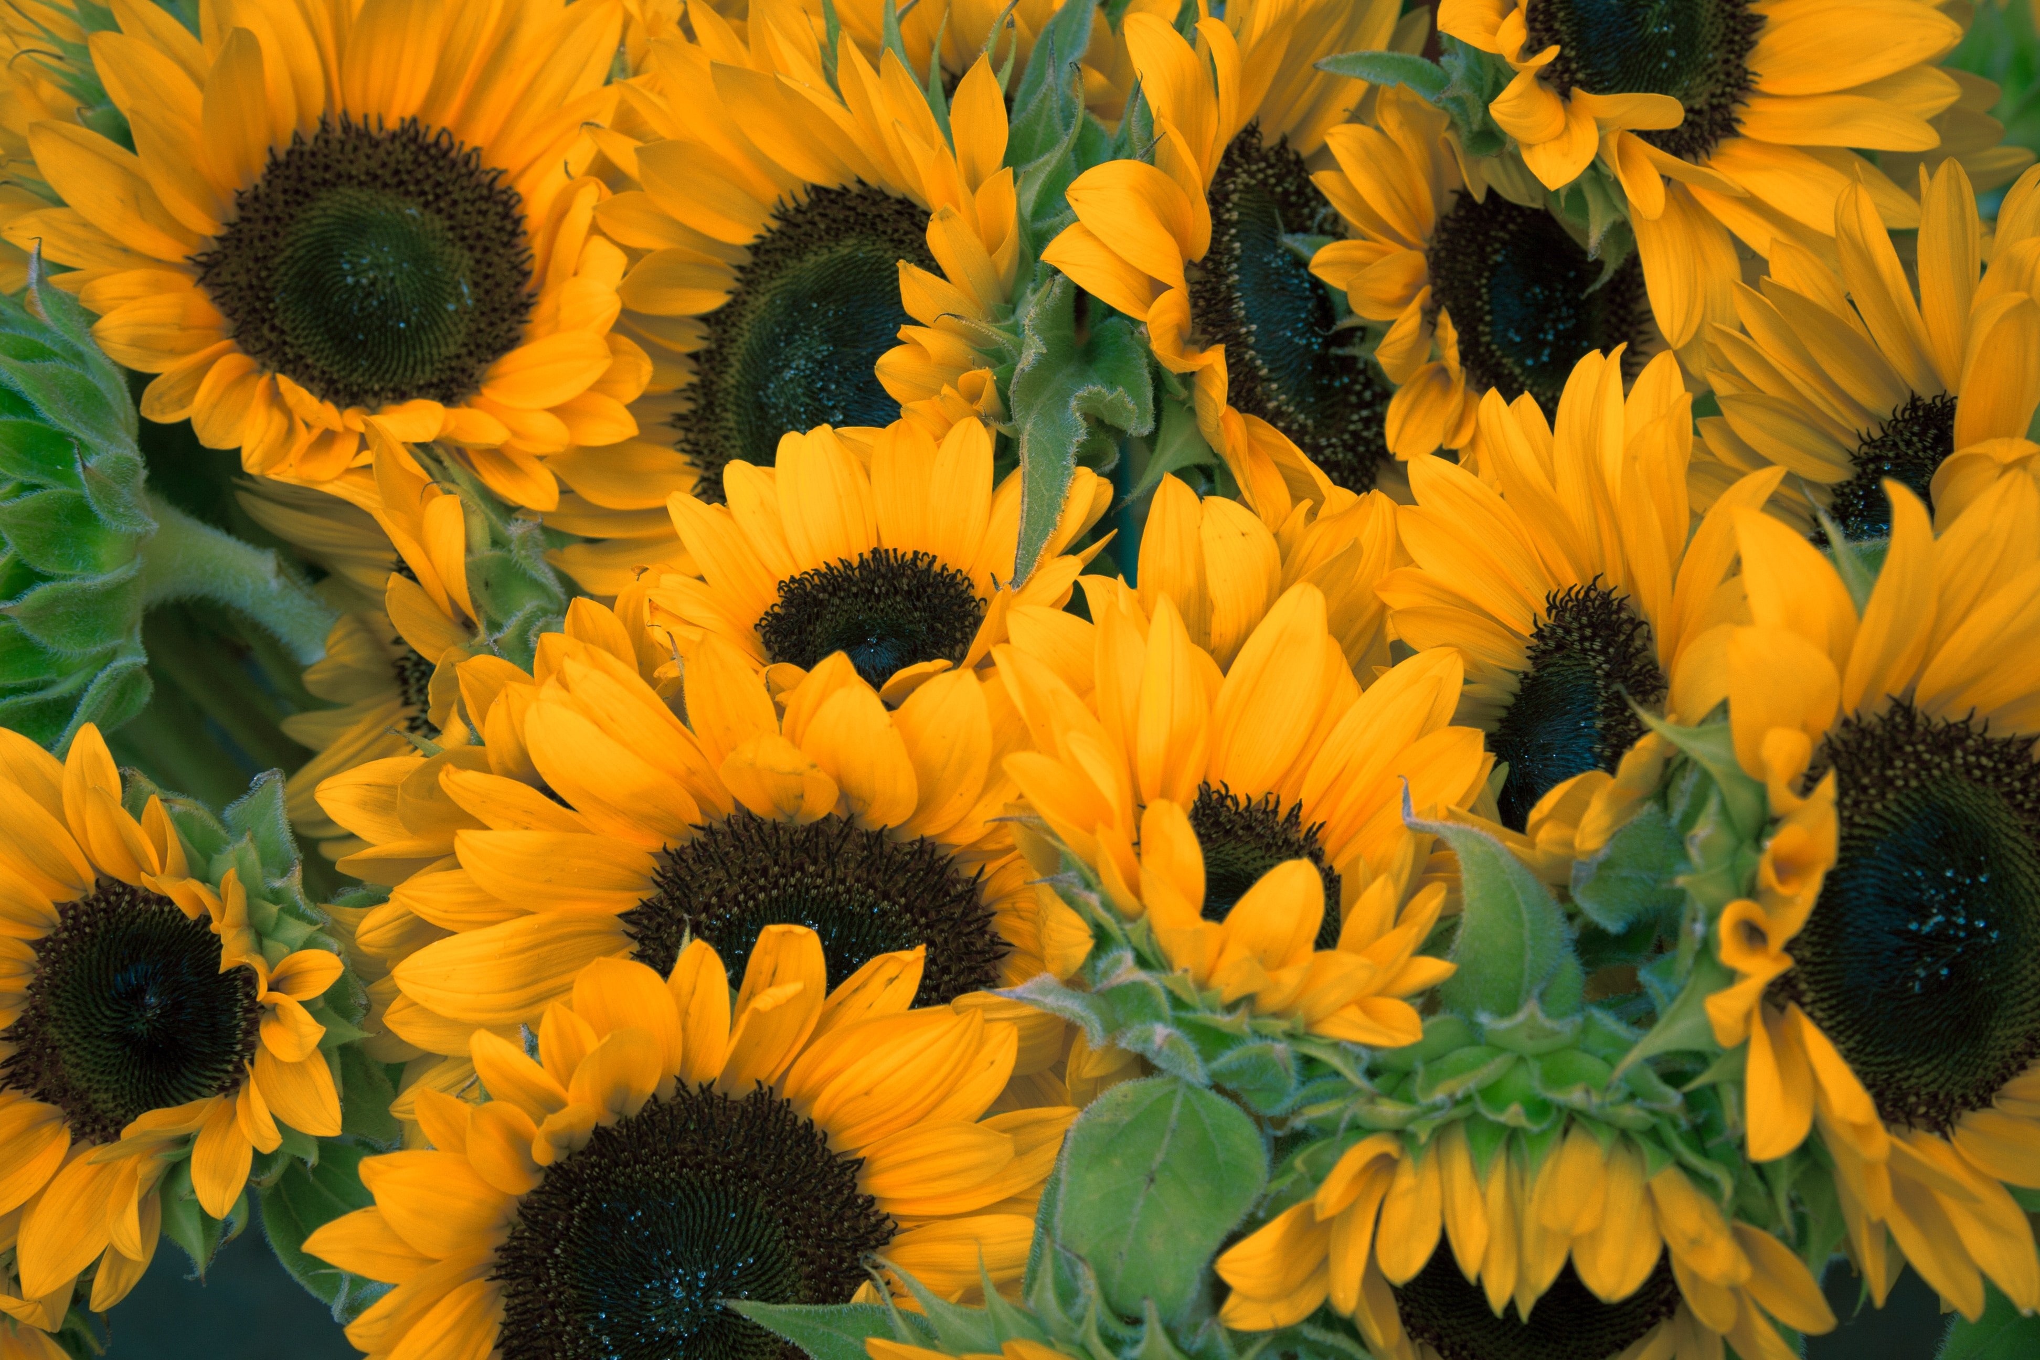
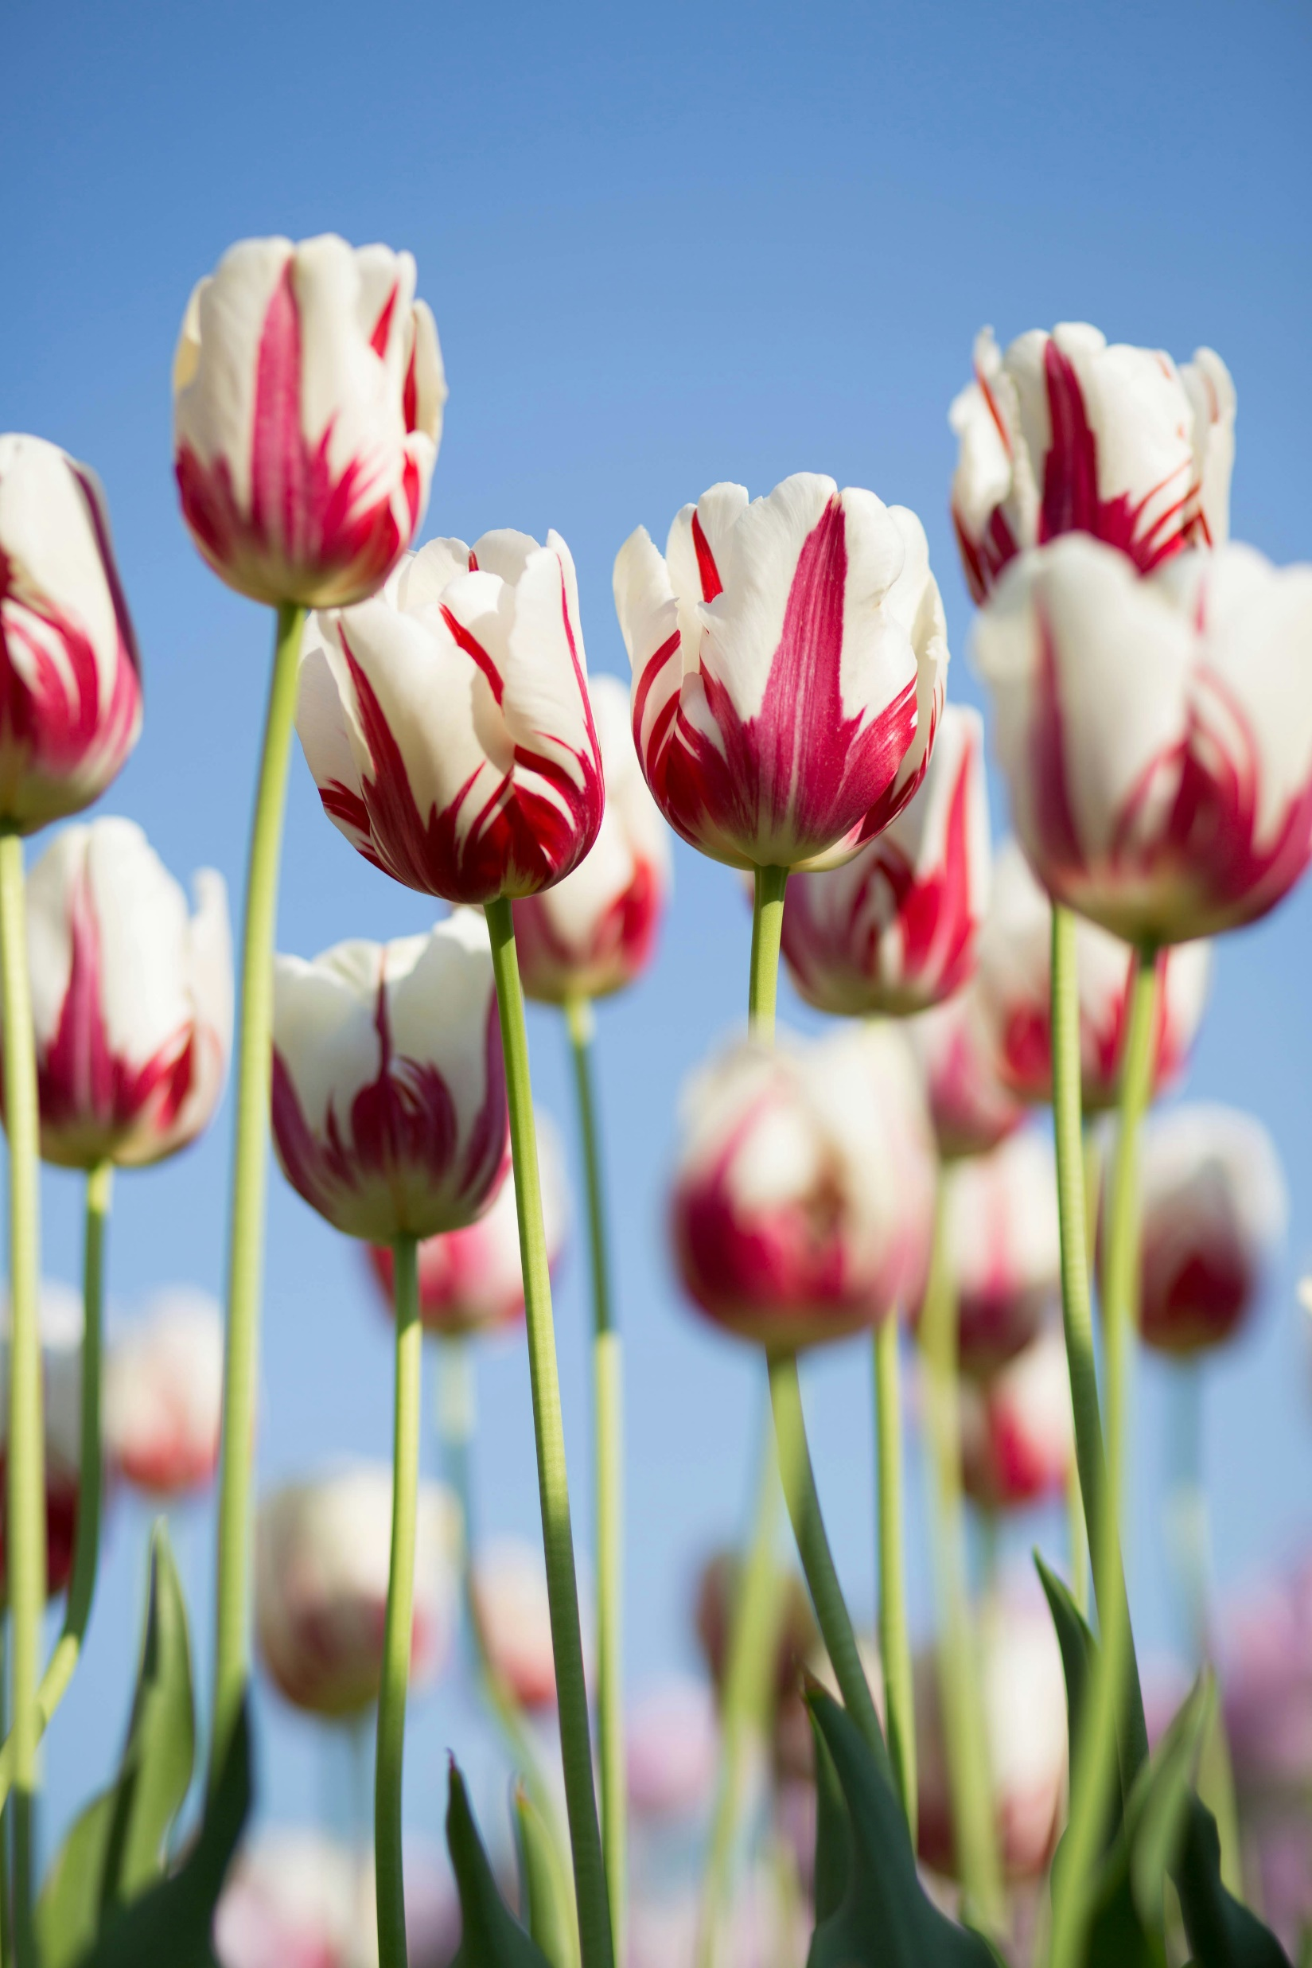
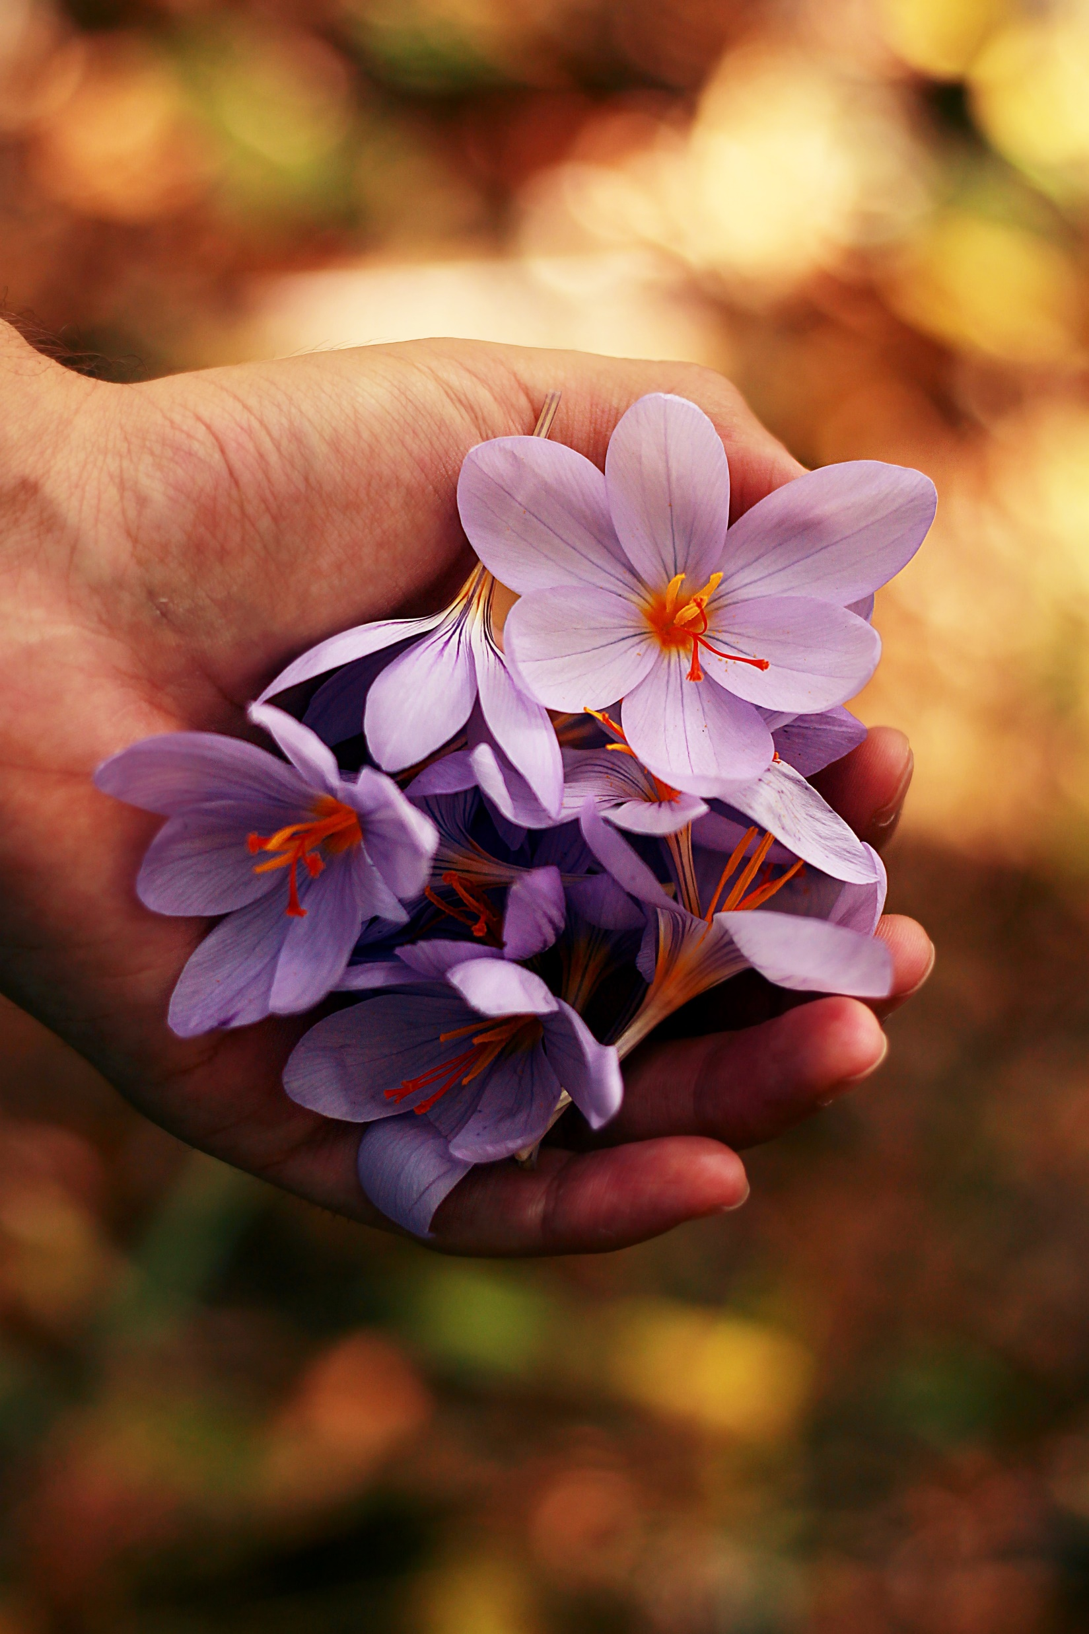
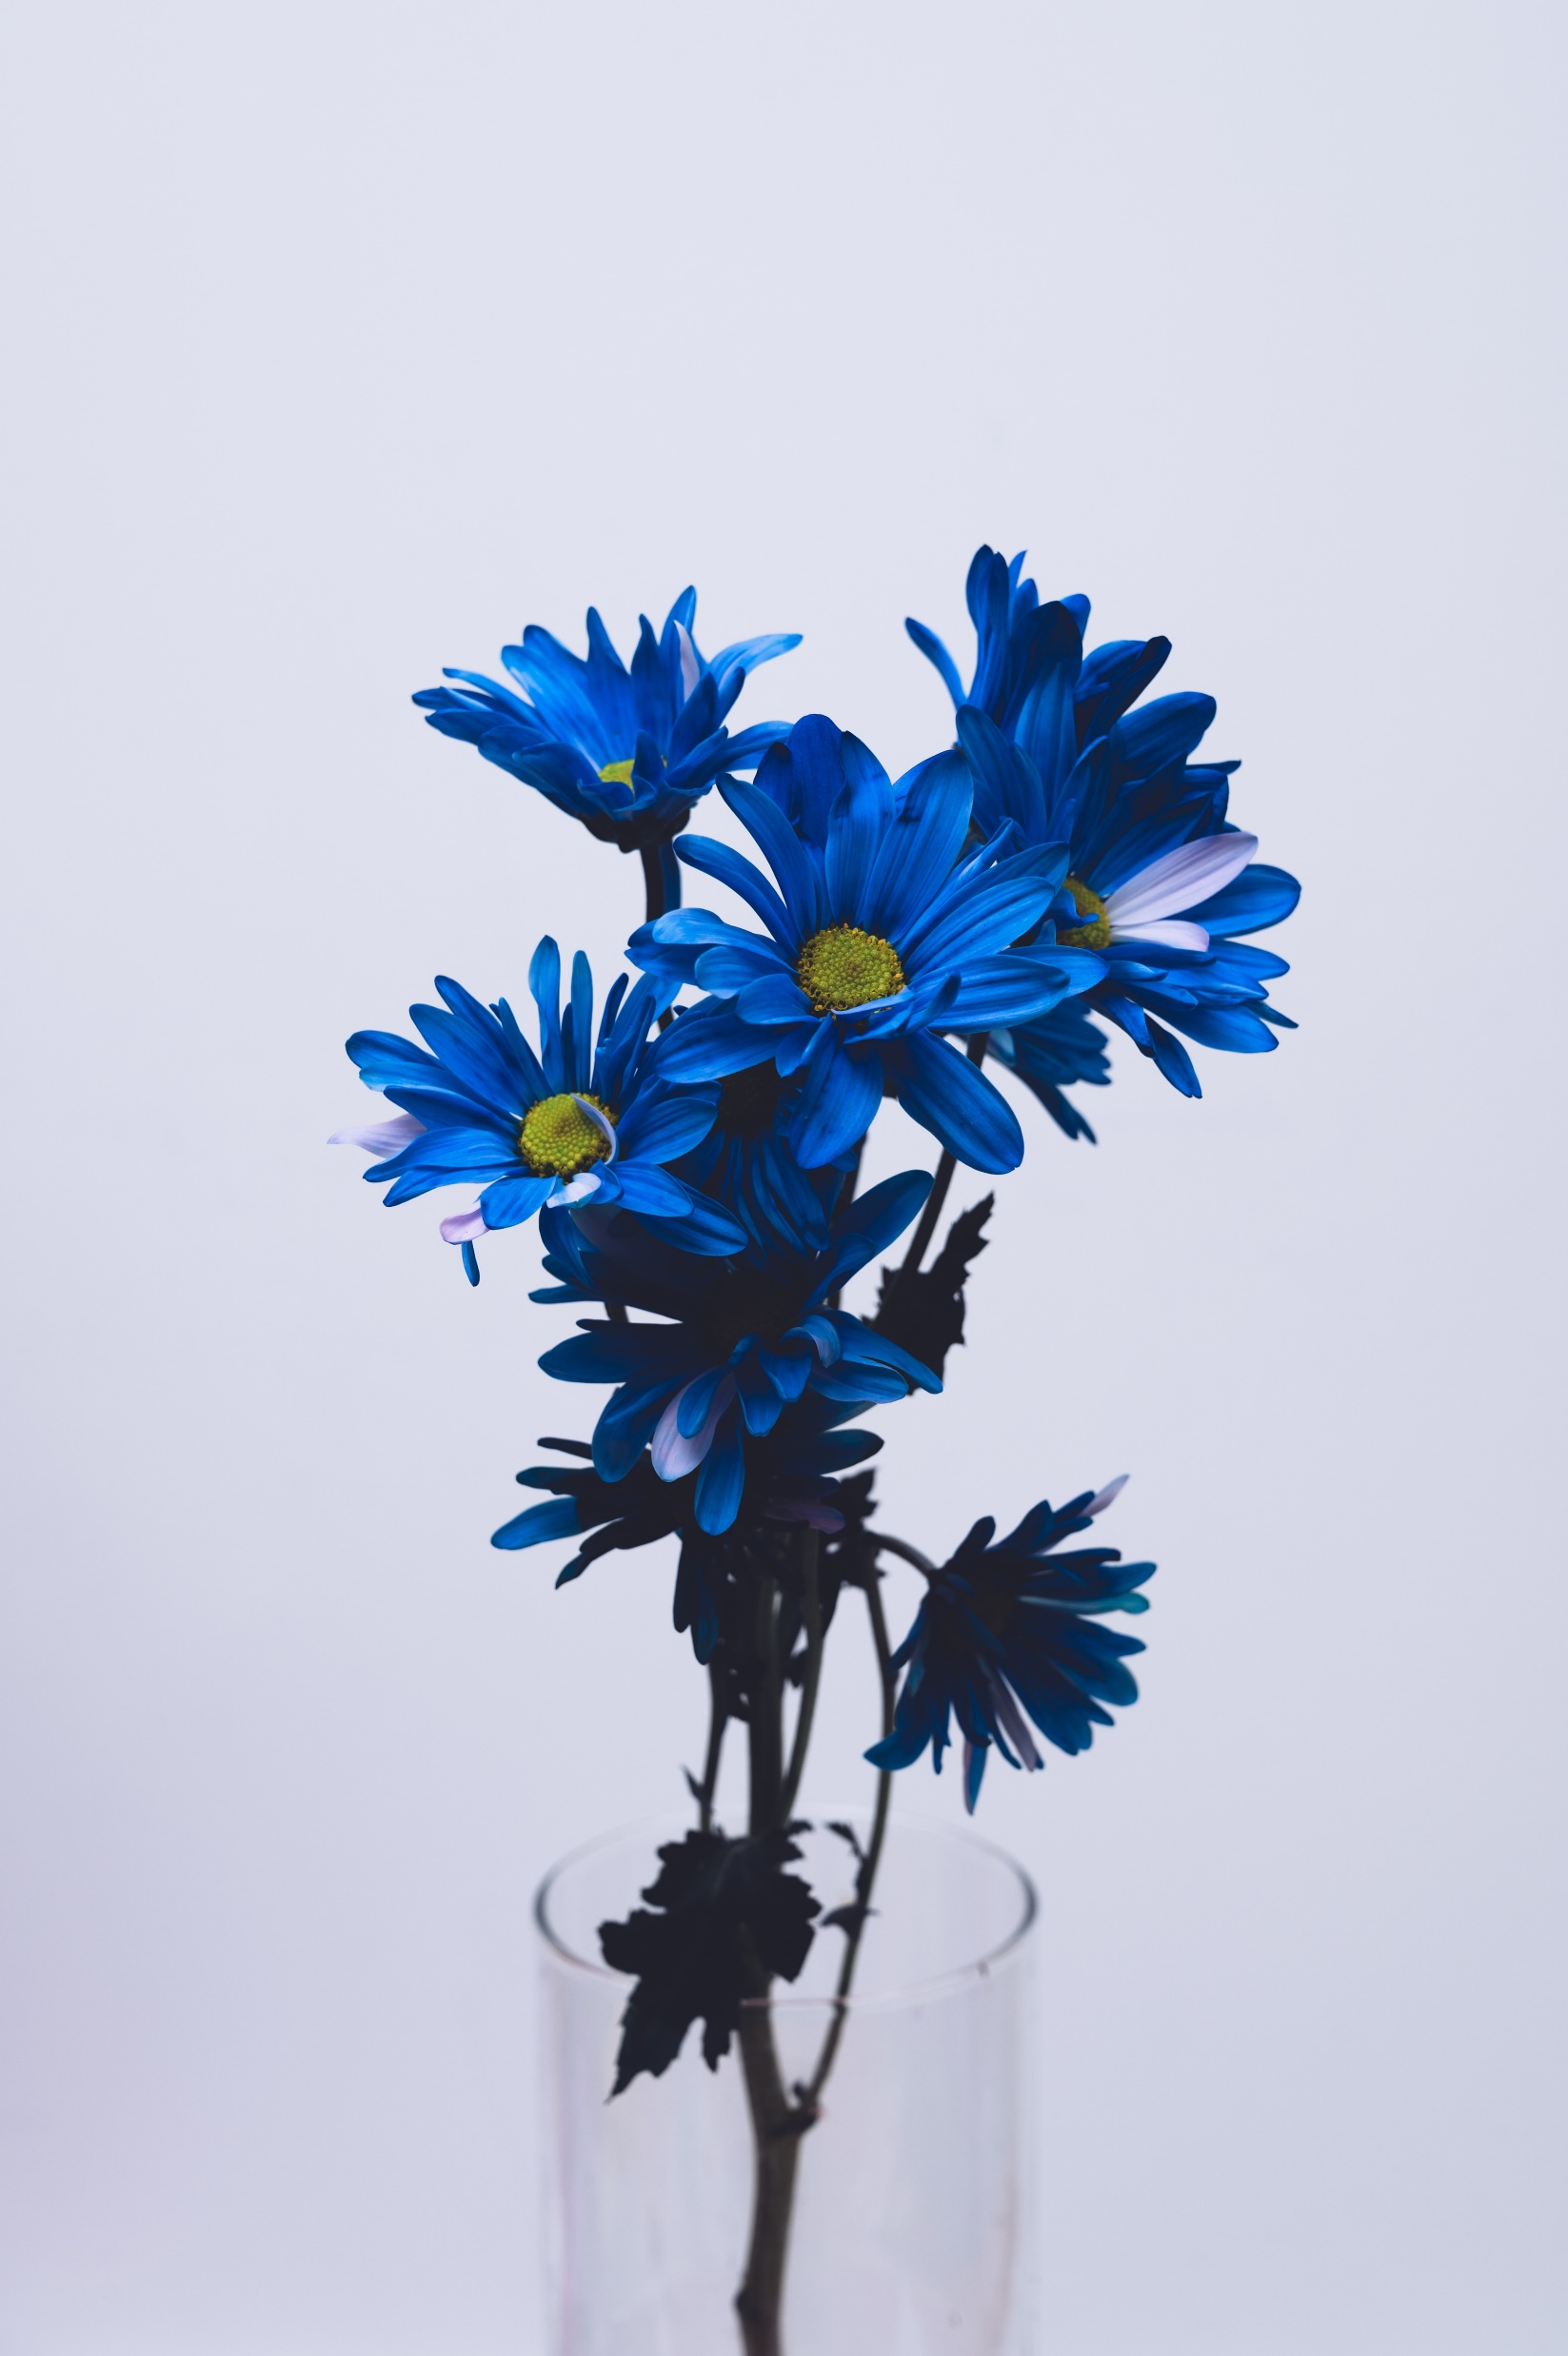

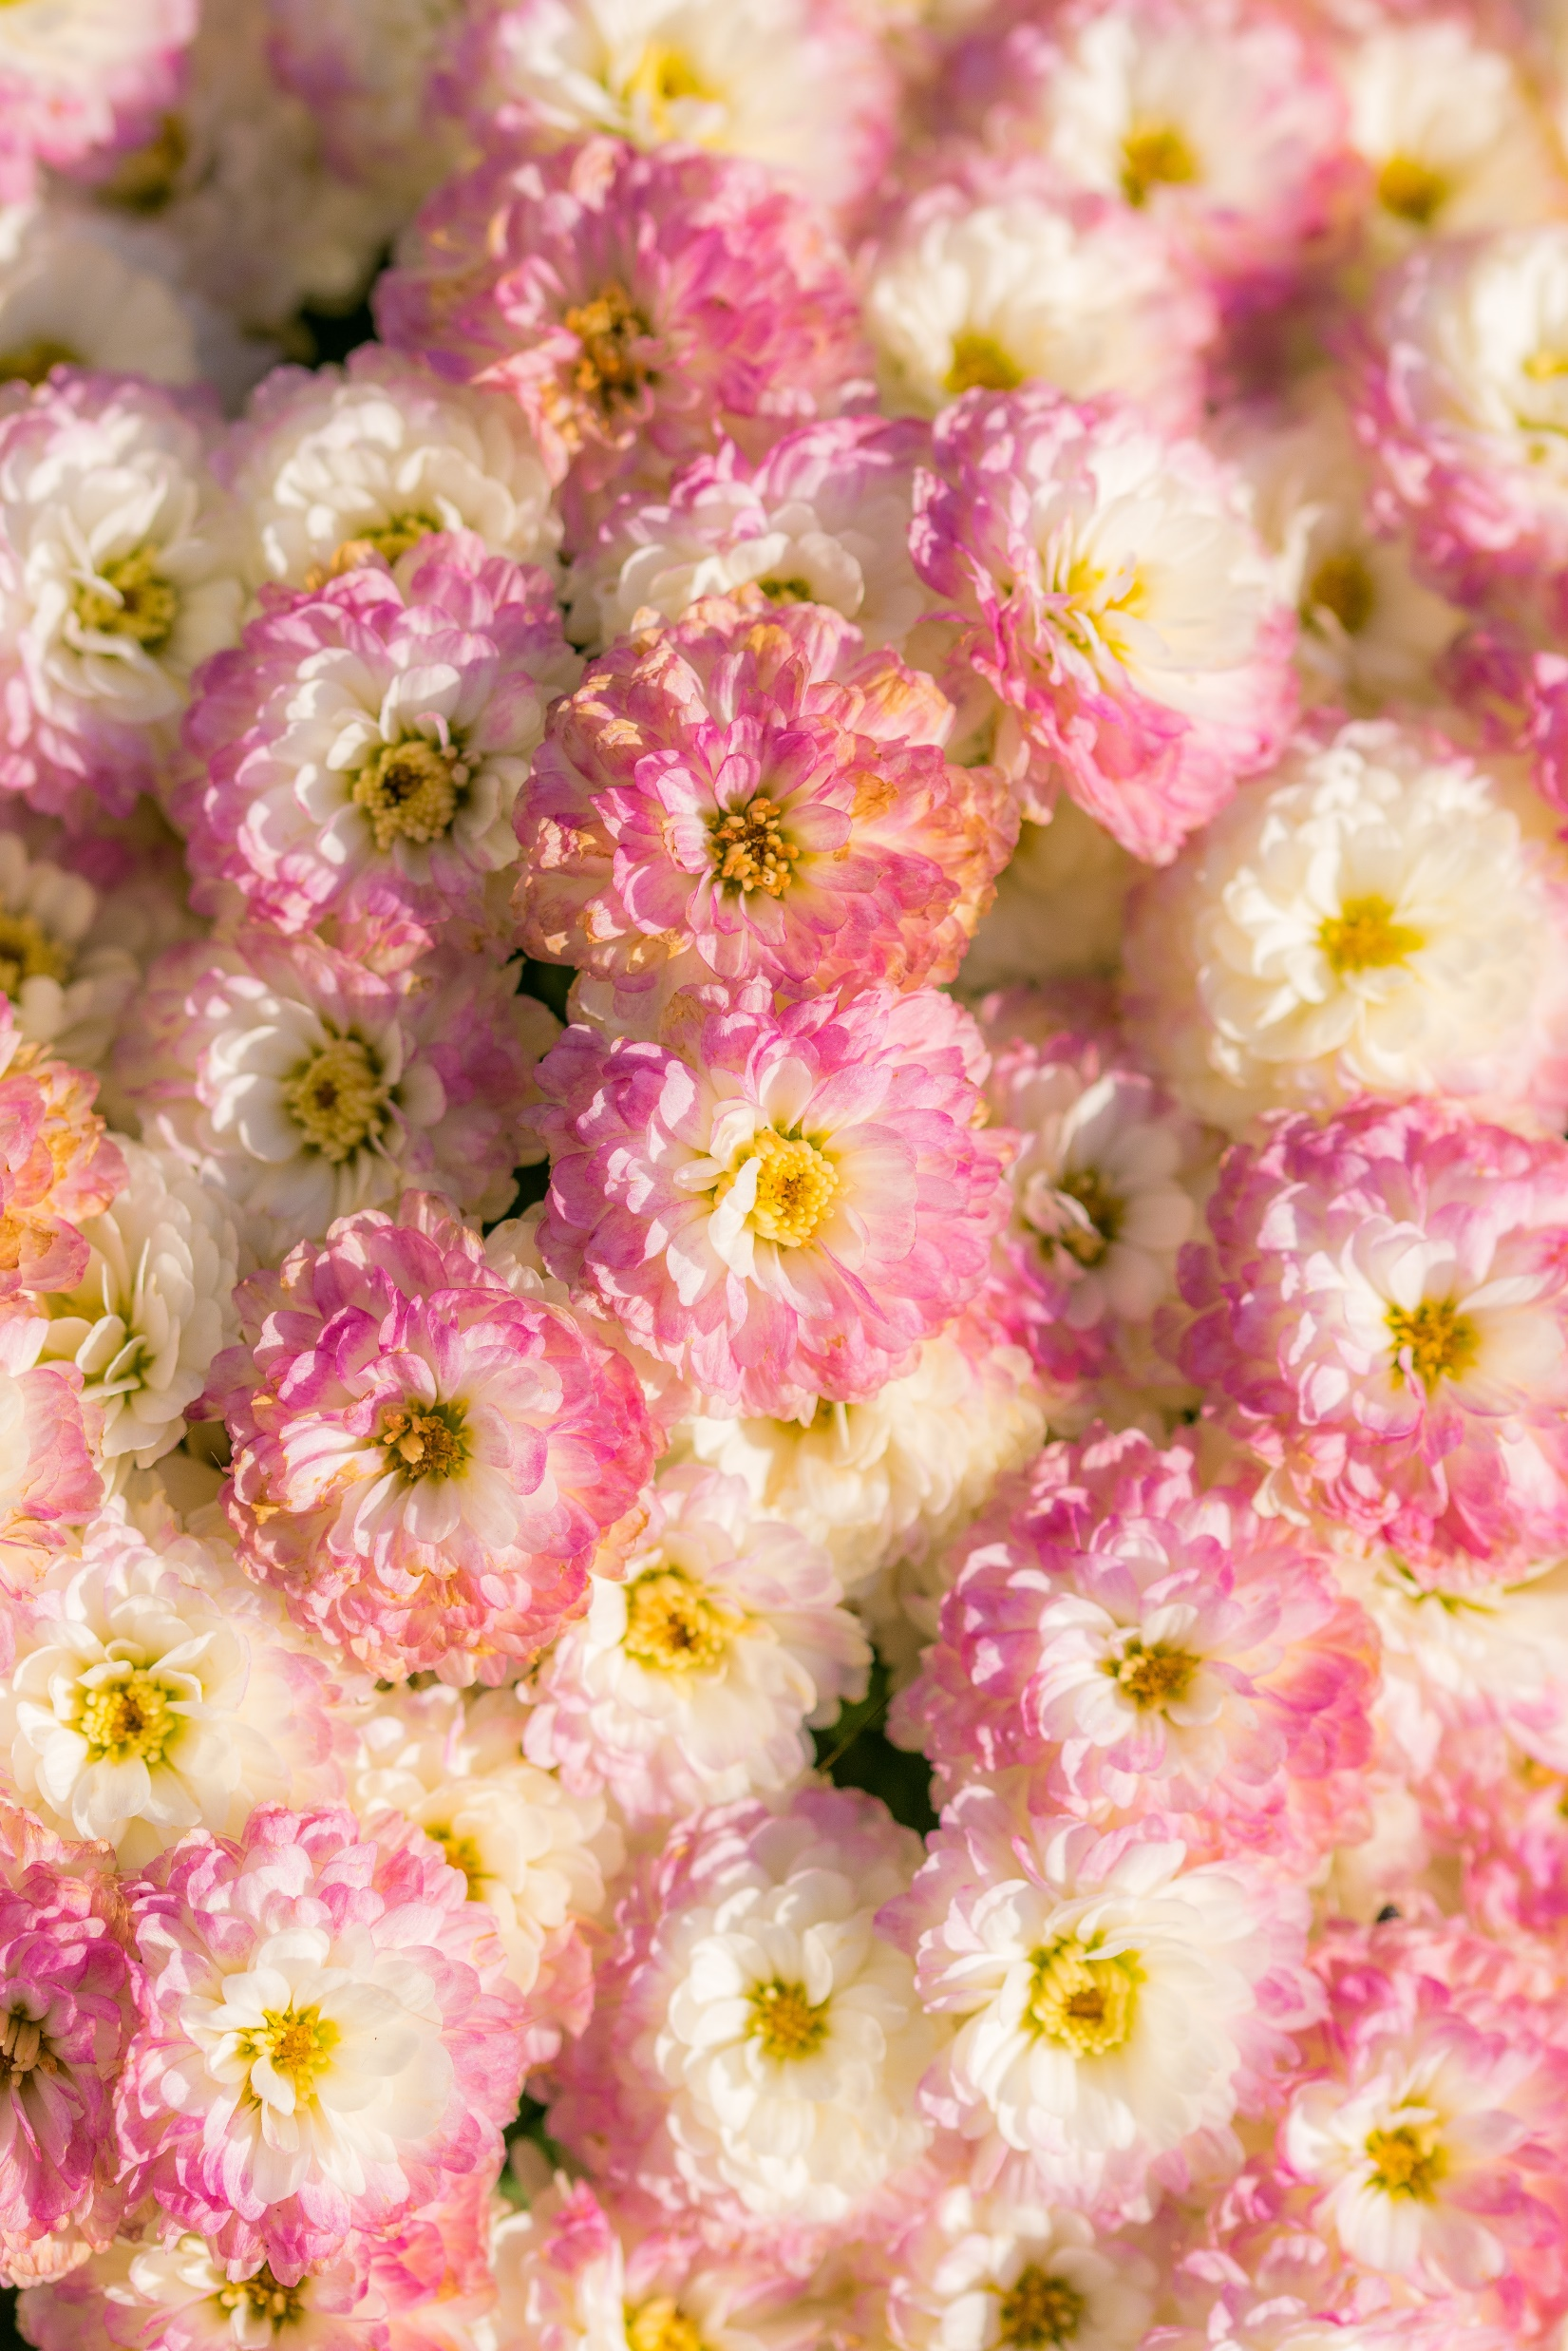






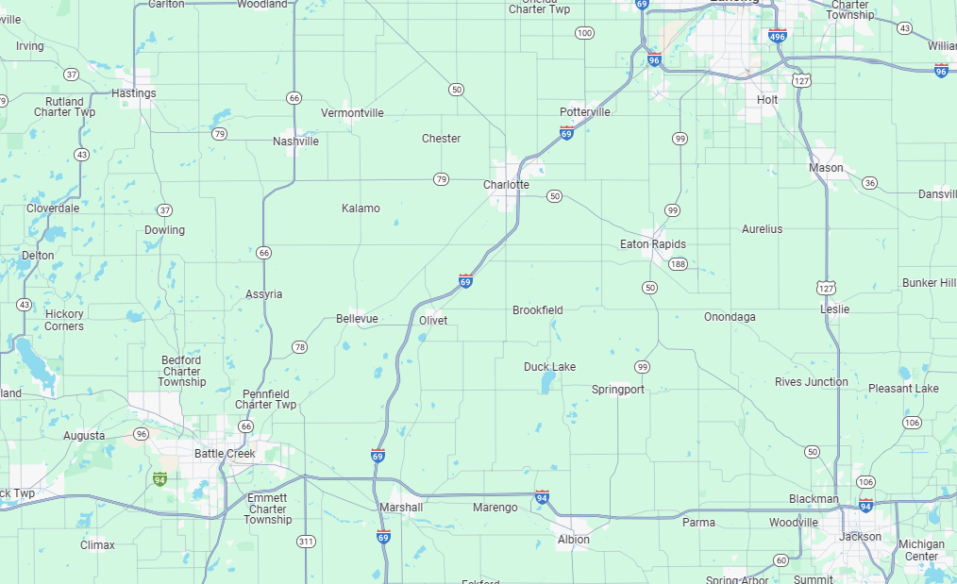
GARDENWAY
About us
Catalog
Delivery
Reviews
Contacts
ENG
Blooms & Beyond:
Your Path To
A Flourishing Garden With Garden Way
ORDER NOW
WHY CHOOSE US
Expertise That Blooms
Quality meets Sustainability
Community of Green Thumbs
Benefit from our team of seasoned horticulturists and dedicated garden enthusiasts, ensuring expert guidance for your garden's success.
Our curated products prioritize quality and sustainability, helping you create a garden that flourishes today and contributes to a greener tomorrow.
Join a vibrant community of like-minded gardeners. Exchange tips, seek advice, and celebrate successes together, making your gardening journey even more enjoyable.
OUR CATALOG
Tulip Tenderness
Bloom Buddy
Petal Pal
Lily Love
Rosey Posy
Blossom BFF
50$ - 60$
10$ - 15$
15$ - 18$
12$ - 19$
20$ - 25$
30$ - 32$
Read more
ABOUT US
Welcome to our blooming corner of the digital garden a space where passion for plants meets expertise in cultivation. At GARDENWAY, we're not just about selling flowers; we're about fostering a love affair with nature, one blossom at a time.
In the heart of our digital garden, you'll find a diverse community of plant enthusiasts who share a common love for the beauty and vitality of greenery. Our journey began with a simple seed of an idea – to create a space where gardening goes beyond a hobby; it becomes a shared passion that binds us together.
Read more
DELIVERY PROCESS
1
2
3
Efficient Dispatch
Transparent Tracking
Contactless Delivery
Swift and secure handling of your order ensures your plants are in good hands right from the start.
Keep tabs on your green companions with real-time tracking, offering peace of mind throughout the delivery process.
A seamless transition awaits your plants at your doorstep, thanks to our contactless delivery, ensuring they arrive in perfect condition for their new home.
DELIVERY PROCESS
Clara
John Smith
Paul
In a world where quality and service often blend, Gardenway stands out as a beacon of excellence. From order to doorstep, their commitment to perfection is unmatched. My heartfelt thanks for bringing the beauty of nature into my home with such finesse and care.
In every leaf and bloom, I found a story of care and commitment Gardenway not only delivered exquisite plants but crafted an experience that spoke volumes about their passion for nature. My home has transformed into a haven of green, all thanks to this remarkable brand.
Choosing Gardenway was like inviting a breath of fresh air into my life. The plants arrived with such grace and beauty, a true testament to the dedication behind each delivery. My gratitude for turning my space into a botanical paradise knows no bounds!
CONTACT US
Address
123 Evergreen Lane
Greenburg Meadows, Botanica
Floralandia, FL 54321
United Petaldom
Working Hours
Mon – Fri | 8 A.M – 9 P-M
Sat – Sun | 1 P.M – 6 P-M
About us
GARDENWAY
Catalog
Delivery
Reviews
Contacts

